Slide 1
Computer Performance ISAs Benchmarking
CDA 3101 Discussion Slides
1 Sep 2022

Slide 2
On the examlet
Performance equation
Average CPI
Calculating speed up
RISC vs CISC
Benchmarking
Parts of a computer

Slide 3
Consider two different implementations of the same instruction set architecture. The instructions can be divided into four classes according to their CPI (class A, B, C, D). P1 has a clock rate of 2.5 GHz and CPIs of 1, 2, 3, and 3. P2 has a clock rate of 3 GHz and CPIs of 3, 3, 3, and 3.
Given a program with an instruction count of 1e6 divided into classes as follows: 10% class A, 20% class B, 50% class C, 20% class D, which is faster, P1 or P2?

Slide 4
Consider two different implementations of the same instruction set architecture. The instructions can be divided into four classes according to their CPI (class A, B, C, D). P1 has a clock rate of 2.5 GHz and CPIs of 1, 2, 3, and 3. P2 has a clock rate of 3 GHz and CPIs of 3, 3, 3, and 3.
Given a program with an instruction count of 1e6 divided into classes as follows: 10% class A, 20% class B, 50% class C, 20% class D, which is faster, P1 or P2?
P1: CPI_{avg} = 1* 0.1 + 2 * 0.2 + 3*0.5 + 3 * 0.2 = 2.6 cycles/instruction
t_{P1} =(1e6 instructions/program * 2.6 cycles/instruction)/2.5e9 cycles/second = 0.00104 seconds

Slide 5
Consider two different implementations of the same instruction set architecture. The instructions can be divided into four classes according to their CPI (class A, B, C, D). P1 has a clock rate of 2.5 GHz and CPIs of 1, 2, 3, and 3. P2 has a clock rate of 3 GHz and CPIs of 3, 3, 3, and 3.
Given a program with an instruction count of 1e6 divided into classes as follows: 10% class A, 20% class B, 50% class C, 20% class D, which is faster, P1 or P2?
P1: CPI_{avg} = 1* 0.1 + 2 * 0.2 + 3*0.5 + 3 * 0.2 = 2.6 cycles/instruction
t_{P1} =(1e6 instructions/program * 2.6 cycles/instruction)/2.5e9 cycles/second = 0.00104 seconds
P2: CPI_{avg} = 3
t_{P2} = (1e6 instructions/program * 3 cycles/instruction)/3e9 cycles/second = 0.0010 seconds

Slide 6
Consider two different implementations of the same instruction set architecture. The instructions can be divided into four classes according to their CPI (class A, B, C, D). P1 has a clock rate of 2.5 GHz and CPIs of 1, 2, 3, and 3.
Given a program with an instruction count of 1e6 divided into classes as follows: 10% class A, 20% class B, 50% class C, 20% class D.
P1: CPI_{avg} = 1* 0.1 + 2 * 0.2 + 3*0.5 + 3 * 0.2 = 2.6 cycles/instruction
t_{P1} =(1e6 instructions/program * 2.6 cycles/instruction)/2.5e9 cycles/second = 0.00104 seconds
What is the speedup of P1 if the the clock rate is improved to 4 GHz?

Slide 7
Consider two different implementations of the same instruction set architecture. The instructions can be divided into four classes according to their CPI (class A, B, C, D). P1 has a clock rate of 2.5 GHz and CPIs of 1, 2, 3, and 3.
Given a program with an instruction count of 1e6 divided into classes as follows: 10% class A, 20% class B, 50% class C, 20% class D.
P1: CPI_{avg} = 1* 0.1 + 2 * 0.2 + 3*0.5 + 3 * 0.2 = 2.6 cycles/instruction
t_{P1} =(1e6 instructions/program * 2.6 cycles/instruction)/2.5e9 cycles/second = 0.00104 seconds
What is the speedup of P1 if the the clock rate is improved to 4 GHz?
Speedup = t_{old}/t_{new} = (IC*CPI/clockrate)_{old}/(IC*CPI/clockrate)_{new}
IC and CPI have not changed

Slide 8
Consider two different implementations of the same instruction set architecture. The instructions can be divided into four classes according to their CPI (class A, B, C, D). P1 has a clock rate of 2.5 GHz and CPIs of 1, 2, 3, and 3.
Given a program with an instruction count of 1e6 divided into classes as follows: 10% class A, 20% class B, 50% class C, 20% class D.
P1: CPI_{avg} = 1* 0.1 + 2 * 0.2 + 3*0.5 + 3 * 0.2 = 2.6 cycles/instruction
t_{P1} =(1e6 instructions/program * 2.6 cycles/instruction)/2.5e9 cycles/second = 0.00104 seconds
What is the speedup of P1 if the the clock rate is improved to 4 GHz?
Speedup = t_{old}/t_{new} = (IC*CPI/clockrate)_{old}/(IC*CPI/clockrate)_{new} = clockrate_{new}/clockrate_{old} =
(4e9cycles/instruction)/(2.5e9cycles/instruction) = 1.6

Slide 9
Consider two different implementations of the same instruction set architecture. The instructions can be divided into four classes according to their CPI (class A, B, C, D). P1 has a clock rate of 2.5 GHz and CPIs of 1, 2, 3, and 3.
Given a program with an instruction count of 1e6 divided into classes as follows: 10% class A, 20% class B, 50% class C, 20% class D.
P1: CPI_{avg} = 1* 0.1 + 2 * 0.2 + 3*0.5 + 3 * 0.2 = 2.6 cycles/instruction
t_{P1} =(1e6 instructions/program * 2.6 cycles/instruction)/2.5e9 cycles/second = 0.00104 seconds
What is the speedup of P1 if the the clock rate is improved to 4 GHz?
Speedup = t_{old}/t_{new} = (IC*CPI/clockrate)_{old}/(IC*CPI/clockrate)_{new} = clockrate_{new}/clockrate_{old} = 4/2.5 = 1.6

Slide 10
Consider two different implementations of the same instruction set architecture. The instructions can be divided into four classes according to their CPI (class A, B, C, D). P1 has a clock rate of 2.5 GHz and CPIs of 1, 2, 3, and 3.
Given a program with an instruction count of 1e6 divided into classes as follows: 10% class A, 20% class B, 50% class C, 20% class D.
P1: CPI_{avg} = 1* 0.1 + 2 * 0.2 + 3*0.5 + 3 * 0.2 = 2.6 cycles/instruction
t_{P1} =(1e6 instructions/program * 2.6 cycles/instruction)/2.5e9 cycles/second = 0.00104 seconds
What is the speedup of P1 if the the clock rate is improved to 4 GHz and class D instructions are improved to CPI=1?

Slide 11
Consider two different implementations of the same instruction set architecture. The instructions can be divided into four classes according to their CPI (class A, B, C, D). P1 has a clock rate of 2.5 GHz and CPIs of 1, 2, 3, and 3.
Given a program with an instruction count of 1e6 divided into classes as follows: 10% class A, 20% class B, 50% class C, 20% class D.
P1: CPI_{avg} = 1* 0.1 + 2 * 0.2 + 3*0.5 + 3 * 0.2 = 2.6 cycles/instruction
t_{P1} =(1e6 instructions/program * 2.6 cycles/instruction)/2.5e9 cycles/second = 0.00104 seconds
What is the speedup of P1 if the the clock rate is improved to 4 GHz and class D instructions are improved to CPI=1?
CPI_{avg} = 1*0.1+2*0.2+3*0.5+1*0.2 = 2.2 cycles/instruction
Speedup = t_{old}/t_{new} = (IC*CPI/clockrate)_{old}/(IC*CPI/clockrate)_{new} = (CPI/clockrate)_{old} / (CPI/clockrate)_{new}
IC is the same

Slide 12
Consider two different implementations of the same instruction set architecture. The instructions can be divided into four classes according to their CPI (class A, B, C, D). P1 has a clock rate of 2.5 GHz and CPIs of 1, 2, 3, and 3.
Given a program with an instruction count of 1e6 divided into classes as follows: 10% class A, 20% class B, 50% class C, 20% class D.
P1: CPI_{avg} = 1* 0.1 + 2 * 0.2 + 3*0.5 + 3 * 0.2 = 2.6 cycles/instruction
t_{P1} =(1e6 instructions/program * 2.6 cycles/instruction)/2.5e9 cycles/second = 0.00104 seconds
What is the speedup of P1 if the the clock rate is improved to 4 GHz and class D instructions are improved to CPI=1?
CPI_{avg} = 1*0.1+2*0.2+3*0.5+1*0.2 = 2.2 cycles/instruction
Speedup = t_{old}/t_{new} = (IC*CPI/clockrate)_{old}/(IC*CPI/clockrate)_{new} = (CPI/clockrate)_{old} / (CPI/clockrate)_{new}
= (2.6/2.5e9) / (2.2/4e9) = 1.89

Slide 13
Consider two different implementations of the same instruction set architecture. The instructions can be divided into four classes according to their CPI (class A, B, C, D). P1 has a clock rate of 2.5 GHz and CPIs of 1, 2, 3, and 3.
Given a program with an instruction count of 1e6 divided into classes as follows: 10% class A, 20% class B, 50% class C, 20% class D.
P1: CPI_{avg} = 1* 0.1 + 2 * 0.2 + 3*0.5 + 3 * 0.2 = 2.6 cycles/instruction
t_{P1} =(1e6 instructions/program * 2.6 cycles/instruction)/2.5e9 cycles/second = 0.00104 seconds
What is the speedup of P1 if the the clock rate is improved to 4 GHz and class D instructions are improved to CPI=1?
CPI_{avg} = 1*0.1+2*0.2+3*0.5+1*0.2 = 2.2 cycles/instruction
Speedup = t_{old}/t_{new} = (IC*CPI/clockrate)_{old}/(IC*CPI/clockrate)_{new} = (CPI/clockrate)_{old} / (CPI/clockrate)_{new}
= (2.6/2.5) / (2.2/4) = 1.89

Slide 14
RISC versus CISC
RISC
Few types of instructions
Simpler hardware
CISC
Many types of instructions
Complex hardware

Slide 15
RISC versus CISC
Few types of instructions means that high level language instructions (e.g. C) turn into many assembly language instructions.
RISC is best when applications are simple.
RISC
Few types of instructions
Simpler hardware
CISC
Many types of instructions
Complex hardware

Slide 16
RISC versus CISC
Lower power consumption and simple hardware makes RISC popular for small, portable (battery powered) devices, and for specialized devices.
ARM is a very popular RISC ISA
RISC
Few types of instructions
Compiles into longer programs
Simpler hardware
CISC
Many types of instructions
Compiles into shorter programs
Complex hardware

Slide 17
RISC versus CISC
RISC
Few types of instructions
Compiles into longer programs
Simpler hardware
CISC
Many types of instructions
Compiles into shorter programs
Complex hardware
CISC is used for general-purpose platforms, like laptops. It’s good for platforms where users compile and run their own programs.
x86 is CISC

Slide 18
Benchmarking
https://www.spec.org/cpu2017/results/

Slide 19
Benchmarking

Slide 20
Benchmarking
Geometric average of ratio values
On average, this platform is 200 times
faster than the baseline machine

Slide 21
Benchmarking
Clock rate

Slide 22
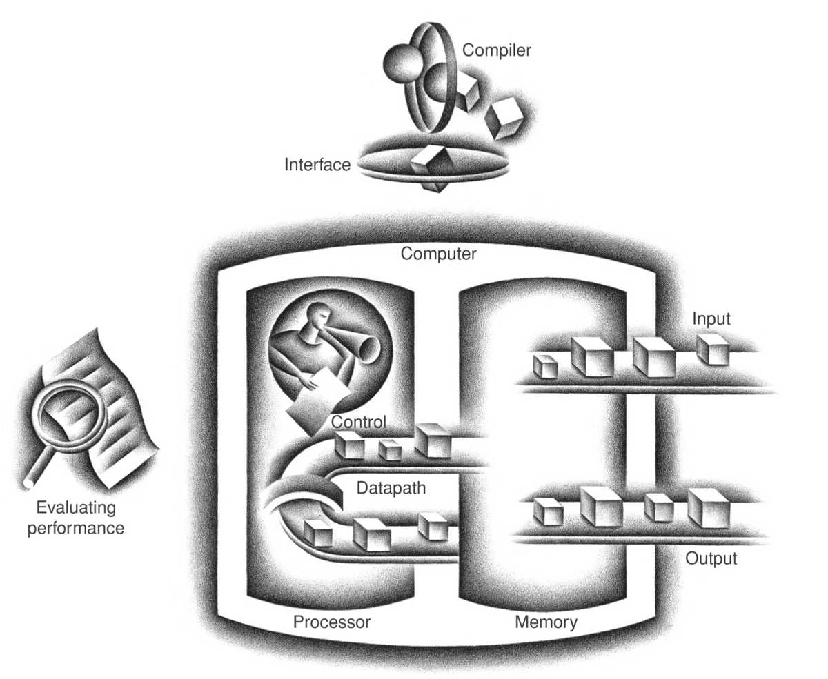
(© Morgan Kaufmann)
Notes:
OFF SCREEN
This slide shows the five main components of a computer: input, output, memory, datapath, and control. [CLICK]
Input writes data [CLICK] and instructions in memory. [CLICK]
The datapath gets data and instructions from memory. [CLICK]
Control sends signals that determine the operations of the datapath, memory, input and output.
[CLICK – Next Slide]

Slide 23
Input writes data and instructions in memory
(© Morgan Kaufmann)
Notes:
OFF SCREEN
This slide shows the five main components of a computer: input, output, memory, datapath, and control. [CLICK]
Input writes data [CLICK] and instructions in memory. [CLICK]
The datapath gets data and instructions from memory. [CLICK]
Control sends signals that determine the operations of the datapath, memory, input and output.
[CLICK – Next Slide]

Slide 24
Datapath executes instructions
(© Morgan Kaufmann)
Notes:
OFF SCREEN
This slide shows the five main components of a computer: input, output, memory, datapath, and control. [CLICK]
Input writes data [CLICK] and instructions in memory. [CLICK]
The datapath gets data and instructions from memory. [CLICK]
Control sends signals that determine the operations of the datapath, memory, input and output.
[CLICK – Next Slide]

Slide 25
Control sends signals that determine the operations of datapath, memory, input and output
(© Morgan Kaufmann)
Notes:
OFF SCREEN
This slide shows the five main components of a computer: input, output, memory, datapath, and control. [CLICK]
Input writes data [CLICK] and instructions in memory. [CLICK]
The datapath gets data and instructions from memory. [CLICK]
Control sends signals that determine the operations of the datapath, memory, input and output.
[CLICK – Next Slide]

Slide 26
Stores instructions and data
(© Morgan Kaufmann)
Notes:
OFF SCREEN
This slide shows the five main components of a computer: input, output, memory, datapath, and control. [CLICK]
Input writes data [CLICK] and instructions in memory. [CLICK]
The datapath gets data and instructions from memory. [CLICK]
Control sends signals that determine the operations of the datapath, memory, input and output.
[CLICK – Next Slide]

Slide 27
Presents results to user
(© Morgan Kaufmann)
Notes:
OFF SCREEN
This slide shows the five main components of a computer: input, output, memory, datapath, and control. [CLICK]
Input writes data [CLICK] and instructions in memory. [CLICK]
The datapath gets data and instructions from memory. [CLICK]
Control sends signals that determine the operations of the datapath, memory, input and output.
[CLICK – Next Slide]

